Slide 1

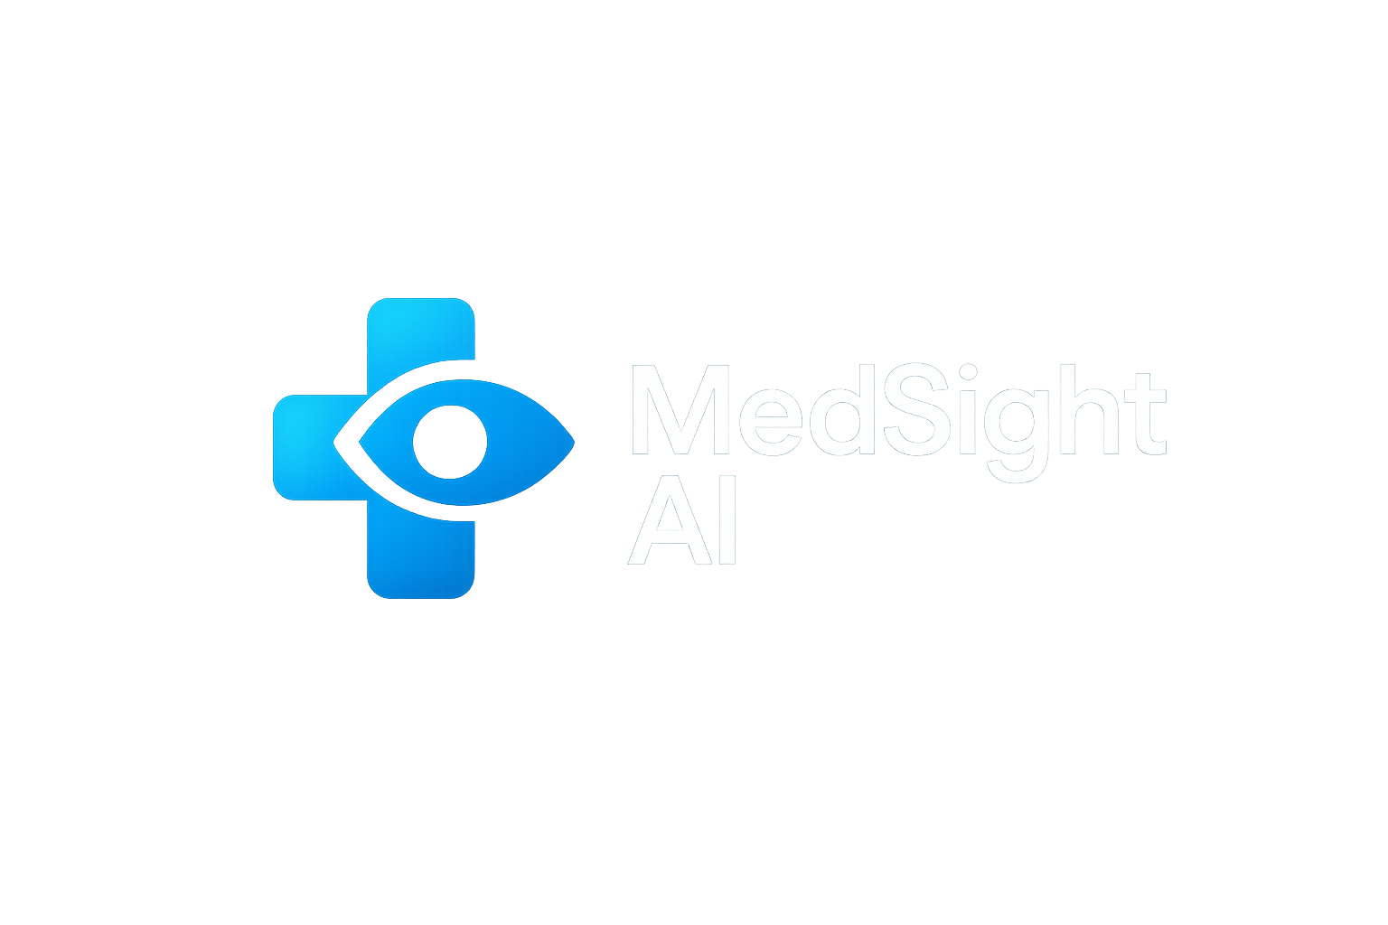
MedSight AI
Reinventing Clinical Decision Support
By: Harshit Barhay

Slide 2

The problem
Doctors face:
  Heavy patient load
  Administrative burden
  Difficulty accessing real-time guidelines
  Risk of oversight due to time pressure
This leads to:
  Delayed diagnosis
  Missed symptoms
  Reduced quality of care

Slide 3
The AI Solution - MedSight AI: An intelligent clinician support assistant
AI capabilities:
  Reads patient notes & summarizes key findings
  Detects warning signs from symptoms
  Suggests possible diagnoses (not final decisions)
  Alerts for drug interactions & allergies
  Generates structured documentation

Slide 4
Market Need
Healthcare systems are overwhelmed globally
Clinicians need:
  Faster insight
  Reduced workloads
  Consistent quality of care
MedSight AI fits into:
  Clinics
  Hospitals
  Telemedicine platforms

Slide 5
Ethics & Safety
No decision-making without human verification
Transparent AI suggestions
Bias monitoring in medical datasets
Privacy: HIPAA-compliant, encrypted storage
Explainable AI for every recommendation

Slide 6
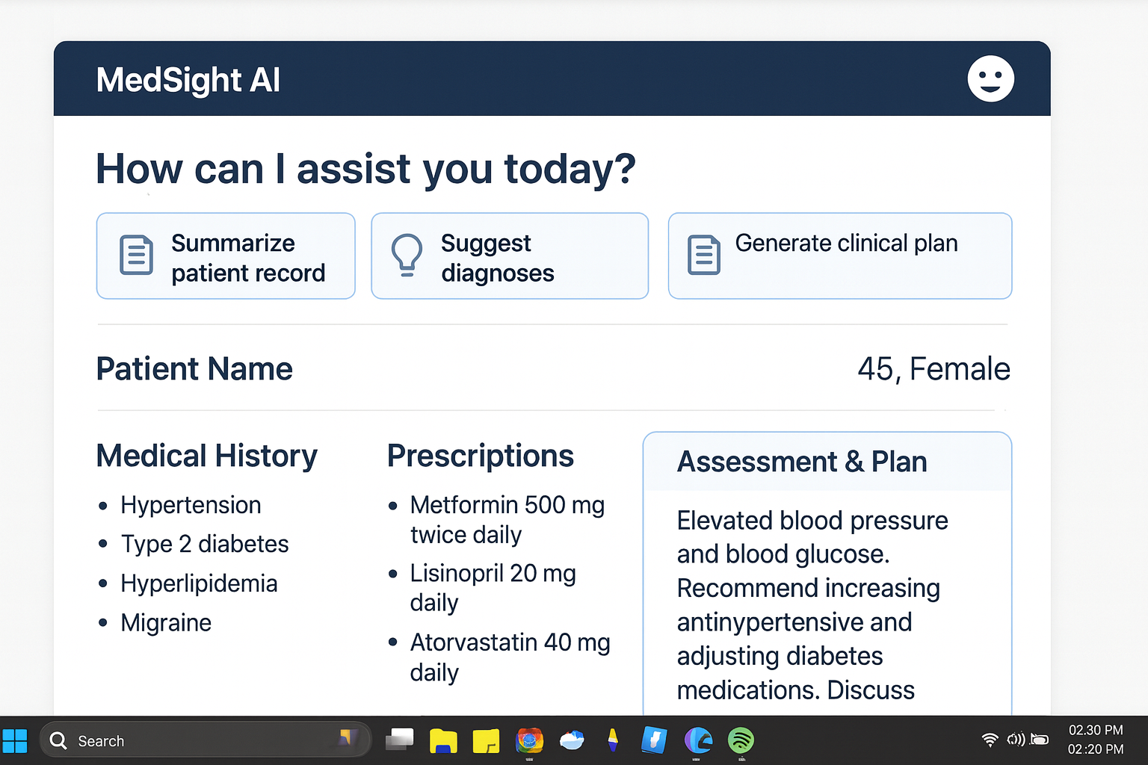
A Glimpse of My product (Generative AI used)

